Slide 1
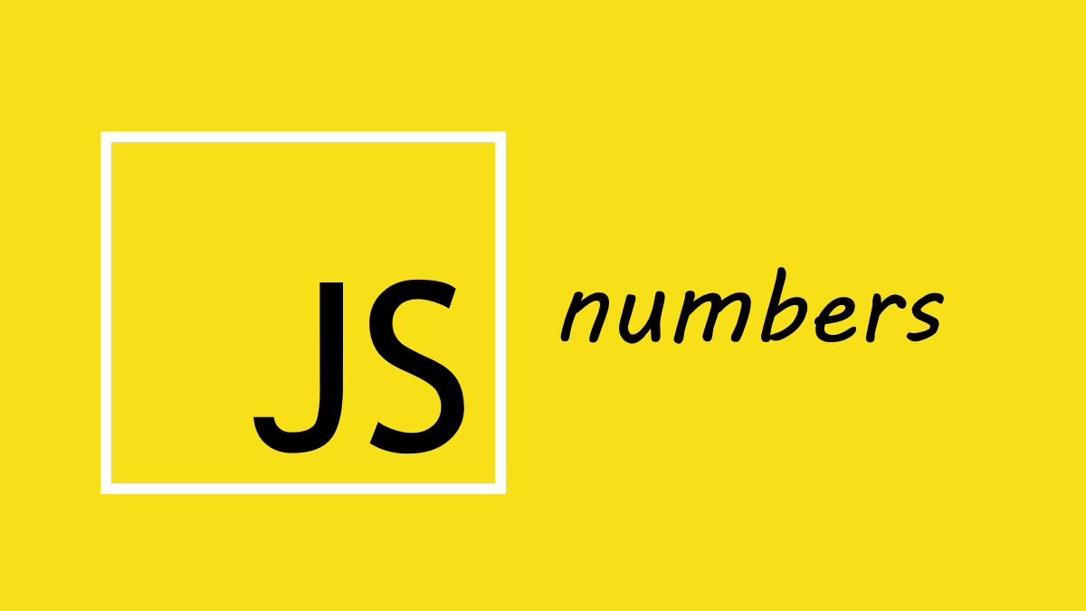

Slide 2
What we Cover Today:
01
02
03
04
Number
Number Methods
Math Object
Exercise

Slide 3
Number
A number is a value for counting or calculating.
In JavaScript, all numbers are the same type (no difference between integer and float).
Example:
let num1 = 24;
let num2 = 10.5;
let num3 = 1_000_000;
let num4 = 1e6;

Slide 4
Number Methods
Number()
The Number() method can be used to convert JavaScript variables to numbers
Example:
Number(true); // 1
Number(false); // 0
Number("10"); // 10
Number("10.33"); // 10.33
Number("10,33"); // NaN
Number("10 33"); // NaN
Number("John"); // NaN

Slide 5
Number Methods
toString()
The toString() method returns a number as a string.
All number methods can be used on any type of numbers (literals, variables, or expressions).
Example:
let x = 123;
x.toString();
(123).toString();
(100 + 23).toString();

Slide 6
Number Methods
toFixed()
The toFixed() returns a string, with the number written with a specified number of decimals.
Example:
let x = 9.656;
x.toFixed(0); // 10
x.toFixed(2); // 9.66
x.toFixed(4); // 9.6560
x.toFixed(6); // 9.656000
Note: toFixed(2) is perfect for working with money.

Slide 7
Number Methods
parseInt()
The parseInt() parses a string and returns a whole number. Spaces are allowed. Only the first number is returned:
Example:
parseInt("-10"); // -10
parseInt("-10.33"); // -10
parseInt("10"); // 10
parseInt("10.33"); // 10
parseInt("10 20 30"); // 10
parseInt("10 years"); // 10
parseInt("years 10"); // NaN

Slide 8
Number Methods
parseFloat()
The parseInt() parses a string and returns a number. Spaces are allowed. Only the first number is returned:
Example:
parseFloat("10"); // 10
parseFloat("10.33"); // 10.33
parseFloat("10 20 30"); // 10
parseFloat("10 years"); // 10
parseFloat("years 10"); // NaN

Slide 9
Number Methods
Number.isInteger()
The Number.isInteger() method returns true if the arguments is an integer.
Example:
Number.isInteger(10); // true
Number.isInteger(10.5); // false
Number.isNaN()
The Number.NaN() method returns true if the arguments is NaN.
Example:
Number.isInteger(123); // false
Number.isInteger(“Ali”); // true

Slide 10
Math Object
Math in JavaScript is a built-in object.
It gives us math tools (methods and properties).
We write: Math.method(number)
Math.round()
The Math.round() returns the nearest integer.
Example:
Math.round(4.6); // 5
Math.round(4.5); // 5
Math.round(4.4); // 4

Slide 11
Math Object
Math.ceil()
The Math.ceil() returns the value of x rounded up to its nearest integer.
Example:
Math.ceil(4.9); // 5
Math.ceil(4.7); // 5
Math.ceil(4.2); // 5
Math.ceil(-4.2); // -4

Slide 12
Math Object
Math.floor()
The Math.floor() returns the value of x rounded down to its nearest integer.
Example:
Math.floor(4.9); // 4
Math.floor(4.7); // 4
Math.floor(4.2); // 4
Math.floor(-4.2); // -5

Slide 13
Math Object
Math.min() and Math.max()
Math.min() and Math.max() can be used to find the lowest or highest value in a list of arguments.
Example:
Math.min(0, 150, 30, 20, -8, -200); // -200
Math.max(0, 150, 30, 20, -8, -200); // 150

Slide 14
Math Object
Math.pow()
The Math.pow(x, y) returns the value of x to the power of y
Example:
Math.floor(8, 2); // 8 x 8 = 64
Math.random()
The Math.random() returns a random number between 0 and 1
Example:
Math.random();

Slide 15
Math Object
Math.trunc()
The Math.trunc(x) returns the integer part of x
Example:
Math.trunc(8.99); // 8

